Slide 1
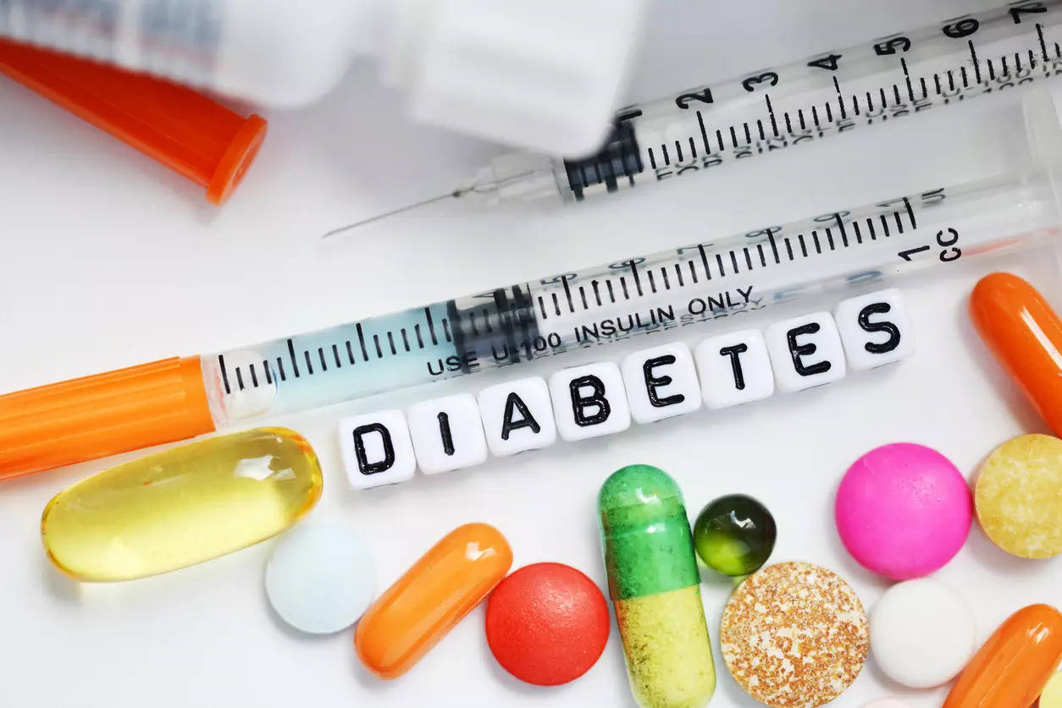
A STATISTICAL STUDY ON DIABETES PREDICTION USING RELEVANT FEATURES
bY
Sujash krishna basak
Sem-vi
Roll no- b.sc(sem-vi)stat-15
Department of statistics,
Visva-bharati,santiniketan

Slide 2
PLAN OF THE PROJECT
DATA DESCRIPTION AND OBJECTIVE OF THE PROJECT
LOGISTIC REGRESSION AND ACCURACY OF MODEL
ANALYSIS OF DATA AND GRAPHICAL REPRESENTATION
INTRODUCTION
CONCLUSION

Slide 3
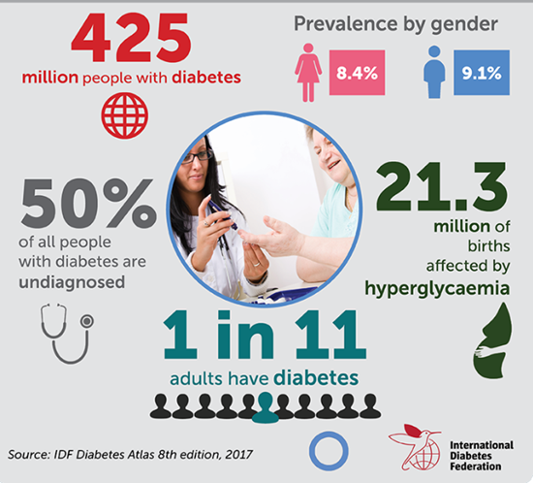
INTRODUCTION
World Health Organization has estimated about 425 million people worldwide have diabetes, the majority living in low and middle income countries and 1.5 million deaths are directly attributed to diabetes each year.
The early prognosis of diabetes can aid in making decisions on lifestyle changes in high risk patients and turn reduce the complications. This project intends to pinpoint the most relevant risk factors of diabetes as well as predict the overall risk using logistic regression.

Slide 4
What is Diabetes?
Diabetes is a serious disease. It happens when our body doesn’t make enough insulin or can’t use it well. This causes high levels of glucose(blood sugar) to build up in the blood. As a result, our body doesn’t work like it should.
What happens in our body?
The food we eat is digested in our stomach. Here it is turned into glucose, or blood sugar
If one has high levels of glucose in our body, means he/she have prediabetes or diabetes.
Blood takes glucose to our cell
Glucose can’t enter into our cells if our body doesn’t make enough insulin, means glucose will build up in our blood .
Glucose must enter into our cells so that we can have energy. Glucose needs the help of insulin to do this

Slide 5
TYPES OF DIABETES
TYPE 1 DIABETES
TYPE 2 DIABETES
GESTATIONAL DIABETES
In this type, the pancreas produces little or no insulin. In the absence of Insulin, blood sugars can become very high, resulting in vomiting, dehydration and acidotic blood. The treatment for this type of diabetes is Insulin.
In this type, the body is unable to use insulin properly due to insulin resistance in the cells. Type 2 diabetes is typically treated through lifestyle changes, medications and sometimes insulin as the disease progresses.
Gestational diabetes starts when the body is not able to make and use all the insulin it needs for pregnancy. Without enough insulin, sugar cannot leave the blood and be used by the cells as a source of energy.

Slide 6
RISK FACTORS OF DIABETES
Modifiable risk factors in diabetes
Non-modifiable risk factors in diabetes
Physical inactivity
Gestational diabetes
High body fat or weight
Race/Ethnicity
Diabetes
High blood pressure
Age over 45 years
High cholesterol
Family history

Slide 7

Problem Definition
1. Major challenge in diabetes is detection
Available instruments are expensive or they cannot predict the chance of diabetes in human
2. Not possible monitoring patients every day
Consultation of a patient for 24 hours by a doctor is not possible since more time expertise is required
3. Presence of good amount of data
We can use various statistical analysis to analyze the data for hidden pattern that can be used for health diagnosis in mediclinical data

Slide 8

Objective of the project
The main aim of this project is to help in the early detection of diabetes. Our primary object is to identify which health parameters provided in the dataset plays the most significant role in the occurrence of diabetes.
Another goal of this project is to identify correlations in our data and using suitable statistical tools to predict whether a woman has a potential chance of developing diabetes or not.

Slide 9
The dataset which is used in this project contains 8 features ( Pregnancies, Glucose, Blood Pressure, Skin Thickness, Insulin, BMI, Diabetes Pedigree Function, Age ) of 392 women and the outcome is if they have diabetes or not. The outcome is a target variable which is a binary dependent variable (yes or no ).
About the Data
Source of the data : https://www.kaggle.com/datasets/uciml/pima-indians-diabetes-database

Slide 10
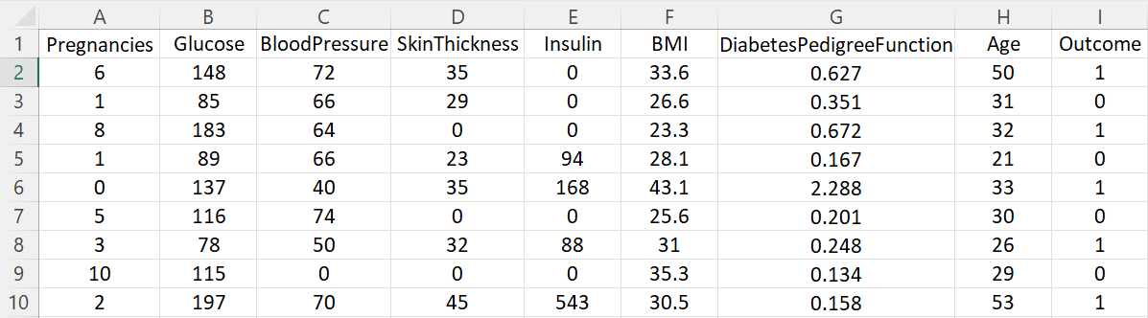
Raw Data

Slide 11
NO | VARIABLE | LABEL
1 | PREGNANCIES | The no of times the woman got pregnant.
2 | GLUCOSE | The concentration of glucose in blood.
3 | BLOOD PRESSURE | The diastolic blood pressure of the person.
4 | SKIN THICKNESS | It displays the triceps skin fold thickness.
5 | INSULIN | It displays the amount of insulin concentration in the blood.
6 | BODY MASS INDEX (BMI) | It displays the body mass index of the person. It is calculated by weight of the person divided by their square of the height.
7 | DIABETES PEDIGREE FUNCTION | It is a function which scores the likelihood of diabetes based on the family history.
8 | AGE | It displays the age of females in the dataset.
9 | OUTCOME | A binary dependent response variable defined as [ 1 : The female have diabetes, 0 : otherwise ]

Slide 12
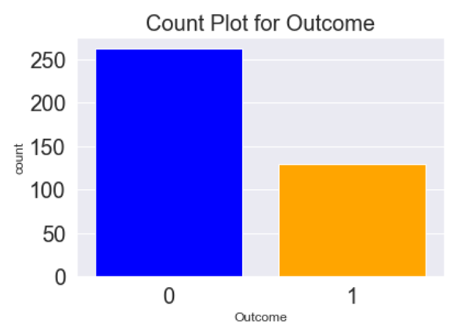
Graphical Representation
The dataset used in this project contains information of 768 women. Out of this, there are 262 non-diabetic females and only 130 females are diabetic patients. The beside graphical representation of count plot will help more to visualize the data.

Slide 13
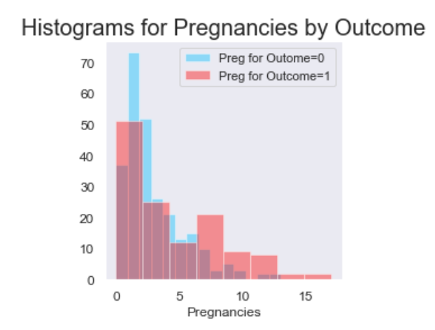
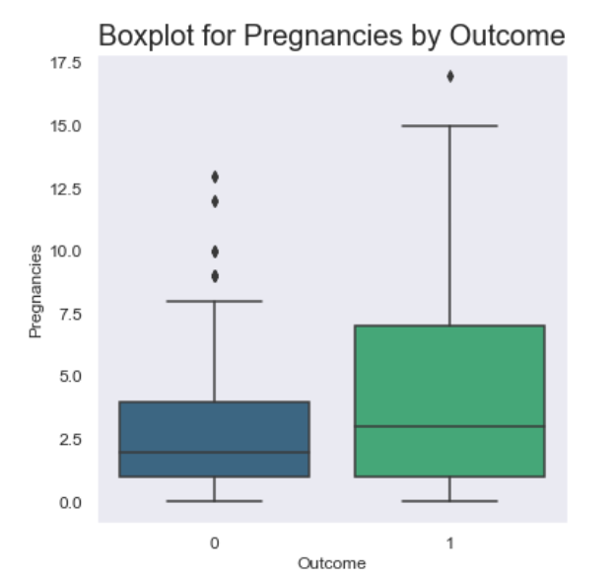
Graphical Screening for variables
1. Screening variable : Pregnancies
Interpretation:
The histograms are rightly skewed.
A large proportions of females are zero count on pregnancies. As the data includes women > 21 years, it is likely that many are unmarried.
It is also visualisable from boxplot that the number of pregnancies is relatively higher for diabetic females than non-diabetic ones.

Slide 14
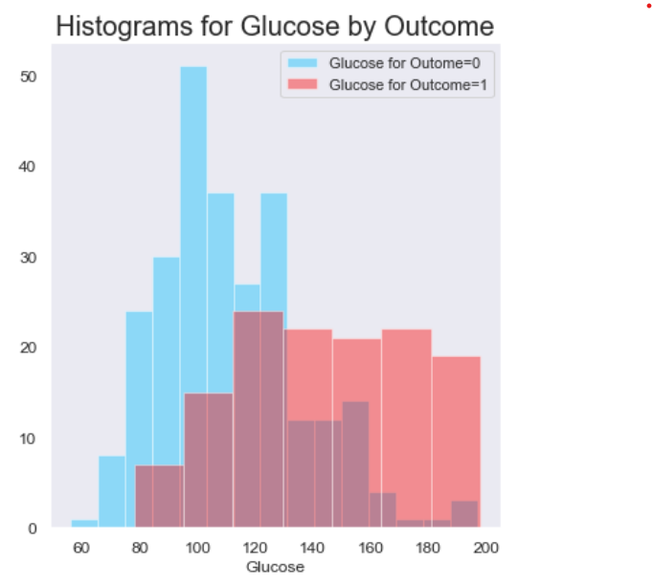
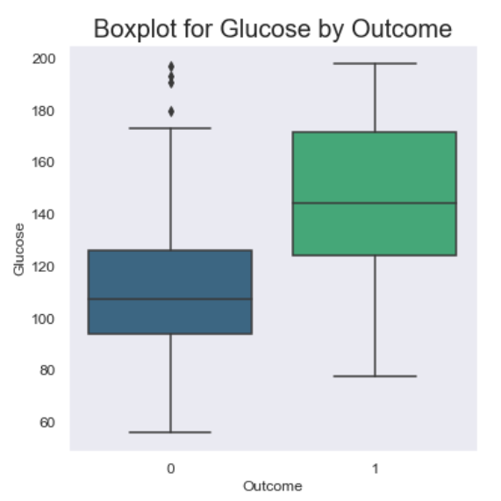
2. Screening variable : Glucose
Interpretation:
From segmented histogram it can be seen that diabetic group has higher glucose than non-diabetic ones.
Boxplot concludes that glucose is quite higher for diabetic females in comparison with non-diabetic females. So a hypothesis that glucose is measure of outcome, is likely to be true.

Slide 15
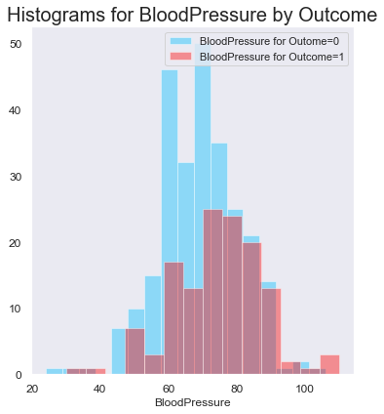
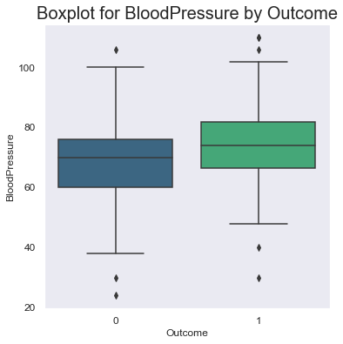
3. Screening variable : Blood Pressure
Interpretation:
It can be seen that the normal range of blood pressure is 60-90
There are few outliers in the data. It’s likely to be some people have low and high BP. We can also observe diabetic females likely to have higher blood pressure than non-diabetic ones.

Slide 16
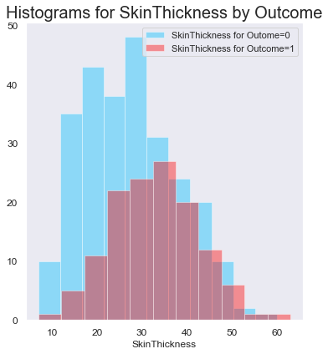
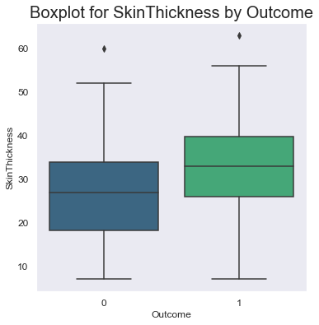
4. Screening variable : Skin Thickness
Interpretation:
The variable is positively skewed. . Like BP, people who are not diabetic have lower skin thickness. As data of non-diabetic is skewed but diabetic samples seems to be normally distributed.
The skin thickness ranges between 20-40 with diabetic females slightly higher

Slide 17
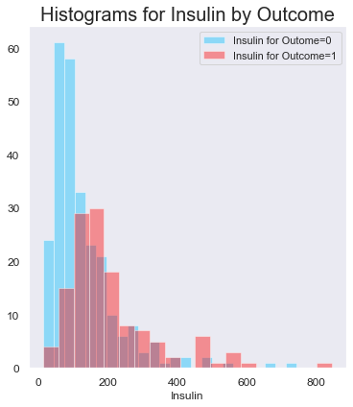
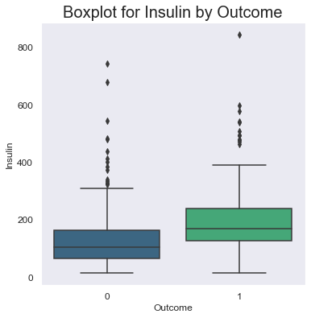
5. Screening variable : Insulin
Interpretation:
Histograms for Insulin is likely to be skewed. From the boxplot, we can observe that the average insulin concentration in the blood for diabetic females is more than that of non-diabetic females in the dataset. Information obtained from the dataset is quite unexpected because diabetes mellitus is the condition in which the body fails to produce much insulin. As a result, a diabetic patient lacks insulin in their body.
There are so many outliers in the variable insulin

Slide 18
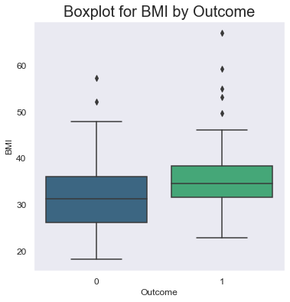
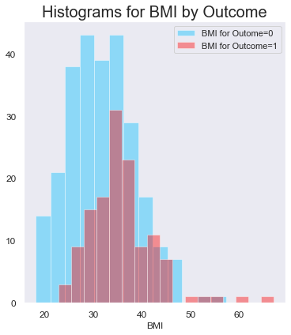
6. Screening variable : BMI
Interpretation:
It can be seen that from histogram there are few outliers. Few are obese in the dataset. Expected range is between 18 to 25. Also it can be observed that diabetic people seems to be only higher side of BMI. Also they contribute more for outliers.

Slide 19
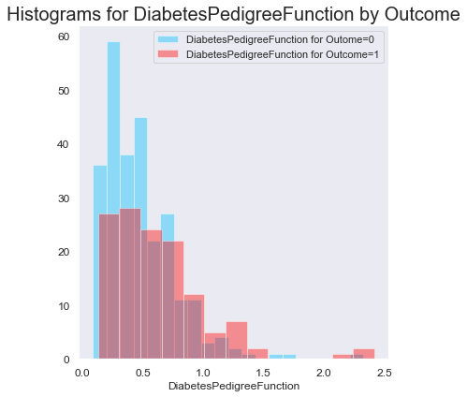
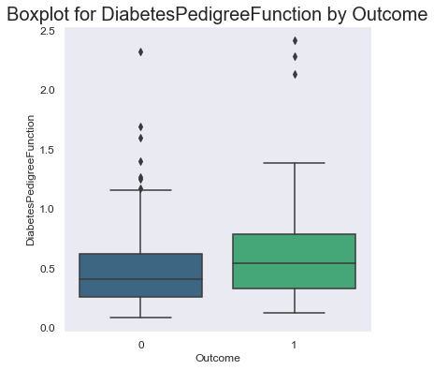
7. Screening variable : Diabetes Pedigree Function
Interpretation:
Data is skewed. As DPF increases, there seems to be a likelihood of being diabetic
The median DPF for the diabetic females is 0.553 whereas, the median DPF for the non-diabetic females is 0.405. So, its slightly higher for diabetic females.

Slide 20
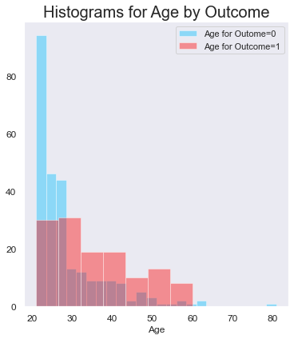
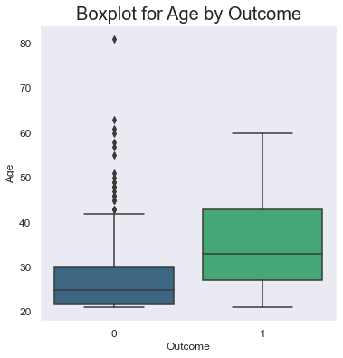
8. Screening variable : Age
Interpretation:
Age is skewed. There is a tendency that as people is aged, they are likely to become diabetic. This needs statistical validation. But diabetes, itself doesn’t seem to have an influence of longevity. May be it impacts quality of life which is not measured in this data set.

Slide 21
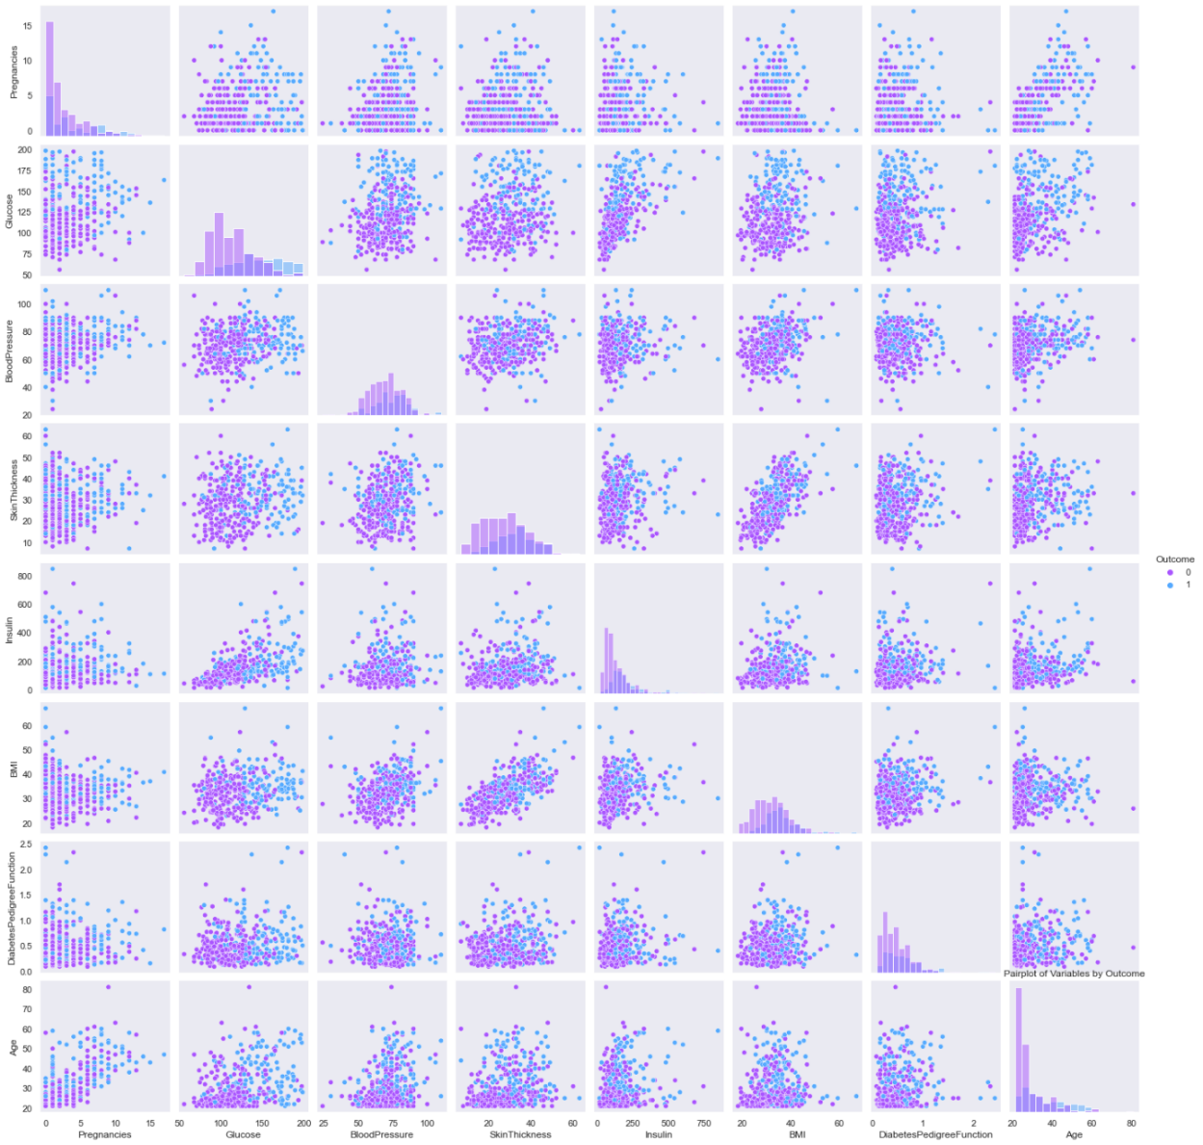
Checking association between variables to study Bivariate relationship
To study the association between variables, we will check the scatterplots of every pairs. From the diagram it can be seen that BMI & Skin Thickness and Pregnancies & Age seem to have positive linear relationships. Another likely suspect is Glucose and Insulin. We can also tell that there is no non-linear relationships.

Slide 22
Testing the significance of the correlation coefficient
Here we perform correlation test to decide whether there is any linear relationship in our data. The outputs are :
VARIABLES | OUTPUT
PREGNANCIES AND AGE | (0.6796084703853149, 1.976788192384777e-54)
GLUCOSE AND INSULIN | (0.5812230123542533, 8.510372268024925e-37)
BMI AND SKIN THICKNESS | (0.6643548666929332, 2.96458292426042e-51)
The above correlation test gives statistically significant association between these pair of variables or we can say there is a linear relationship between these variables.

Slide 23
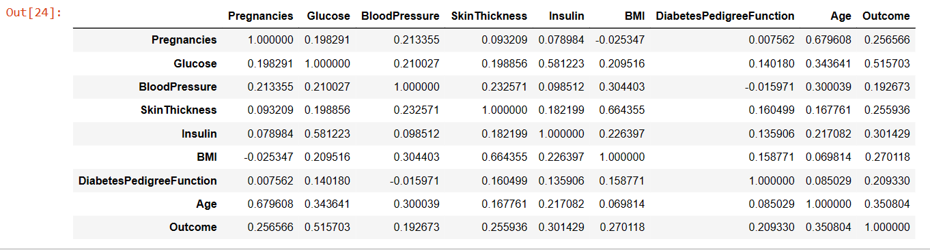
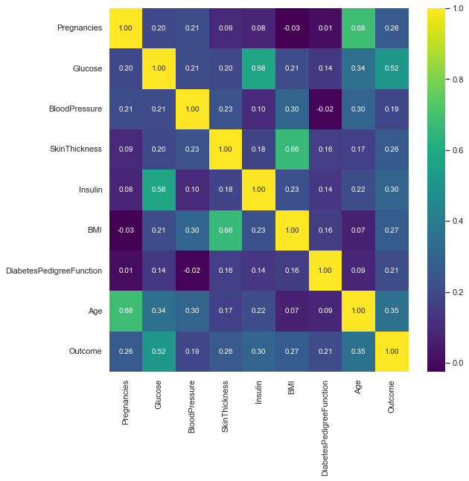
Correlation matrix and HEATMAP
The heatmap gives a better understanding that the variables BMI & Skin Thickness (0.664355), Pregnancies & Age (0.679608), and Glucose and Insulin (0.581223) have a linear relationship between them and no two variables have strong linear relationships.

Slide 24
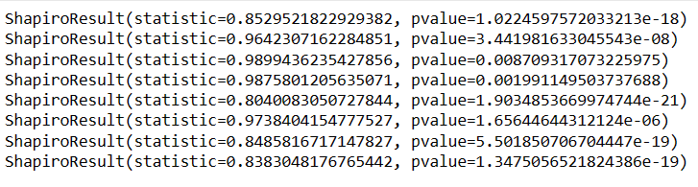
Shapiro-Wilk Test for Normality checking
Interpretation : For level of significance α = 0.05, it can be seen that all the p-value of the 8 variables are less than α=0.05. So, the null hypothesis is rejected and we conclude that the datasets are not from the normal distribution.

Slide 25
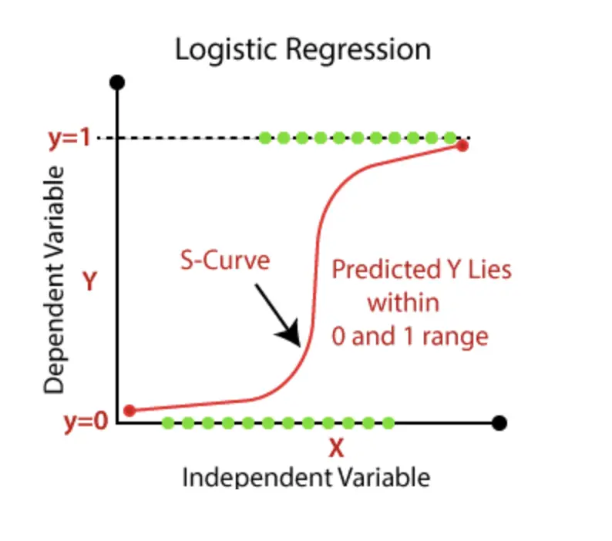
WHAT IS LOGISTIC REGRESSION ?
Logistic Regression is a statistical method for analyzing a dataset which contains one or more independent variables , that determine an outcome
The outcome is measured with discrete nominal binary variable. Must be coded as 0, 1
In our data response variable has only 2 outcome yes or no , so we are going to apply logistic regression.
The goal of logistic regression is to find the best fitting model to describe the relationship between target variable and set of independent variables and to predict the occurrence of any happening.

Slide 26
Why It is called Logistic Regression ?
In logistic regression we want to model the probability of an event rather than a measure
Probabilities ranges from 0 to 1
Thus dependent variable should be as a probability range, which requires a transformation from the nominal binary variable
Name of the transformation is logit transformation.

Slide 27
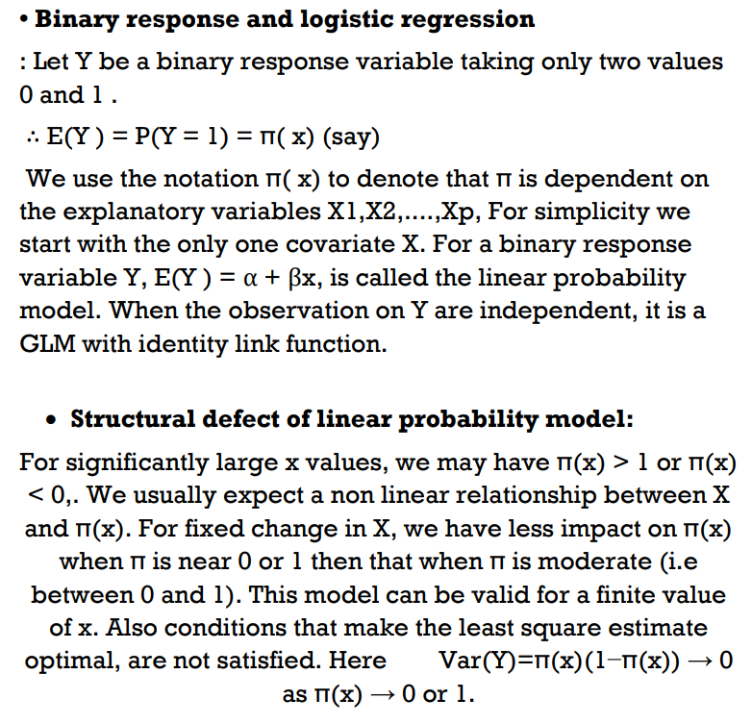
Mathematics behind logistic regression

Slide 28
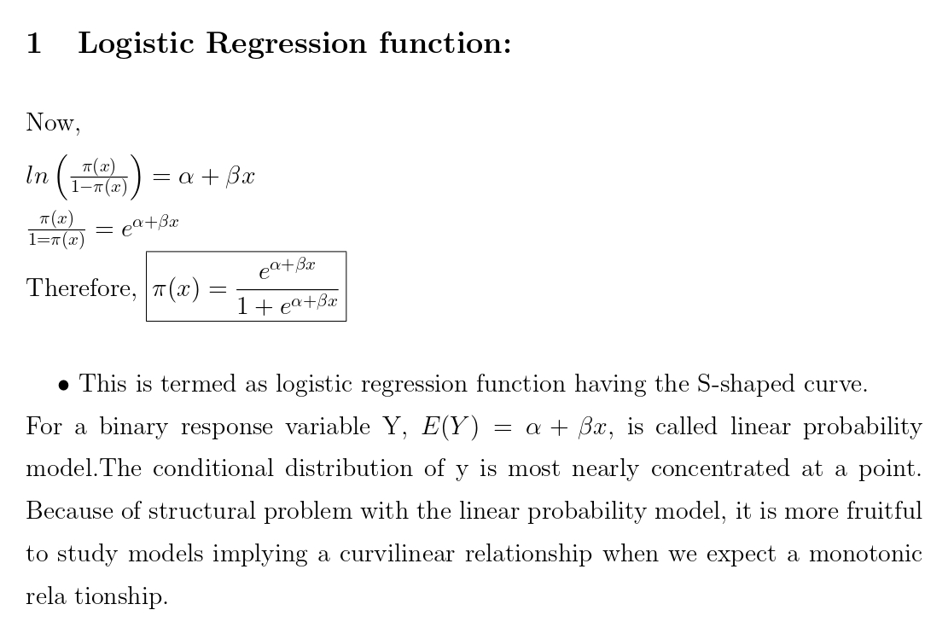

Slide 29
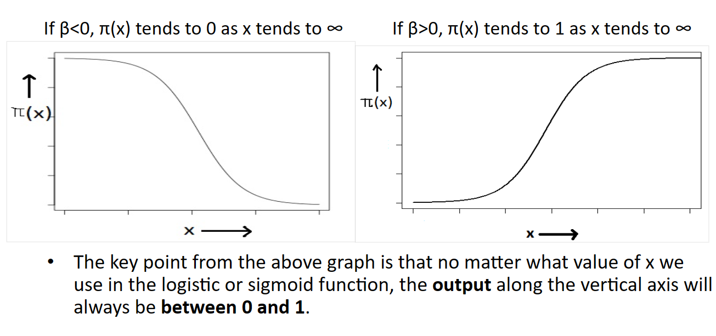
Logistic regression function graph

Slide 30

Analysis of the data
In our dataset, target variable y (OUTCOME) is a binary dependent variable responses 1 and 0 with probability, $Π\left(x_{i}\right)=Π_{i}$ and 1-$Π_{i}$ .There are 8 covariates or predictor variables to predict the probability of diabetes. They are ’Pregnancies’ (x1), ’Glucose’ (x2) , ’Blood Pressure’ (x3) , ’Skin Thickness’ (x4) , ’Insulin’ (x5) , ’BMI’ (x6) , ’ Diabetes Pedigree Function’ (x7) , ’Age’ (x8).
We take the g(μ) as g(μ) = log[μ/(1 − μ)] models the log of odds. It is appropriate when μ is between 0 and 1 , such as a probability. This is called the logit link . A GLM that uses the logit link is called a logistic regression model. Now,
μ = p(𝑥1, 𝑥2, . . , 𝑥7) = $\frac{ⅇ^{β_{1}x_{1}++β_{2}x_{2}+…⋅⋯+β_{8}x_{8}}}{1+ⅇ^{β_{1}x_{1}+β_{2}x_{2}+…⋅⋯+β_{8}x_{8}}}$
in 𝑥1.
Now we will try to fit our model and iterate to get more improved result.

Slide 31
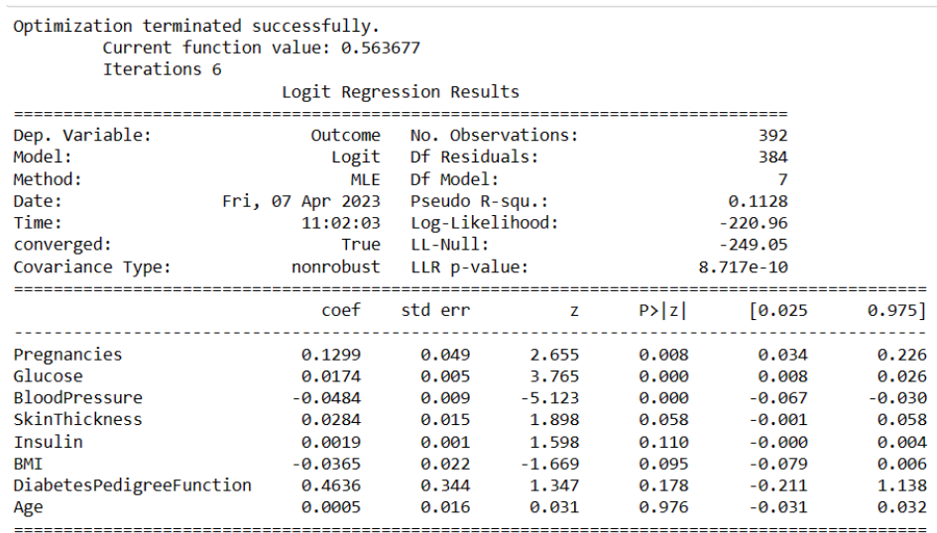
Diabetes prediction with all covariates
(MODEL 1)
Interpretation:
R-squared value: 56.3677%
D.P.F., Age, Insulin are not contributing significantly. So, we will eliminate them in the next model.

Slide 32
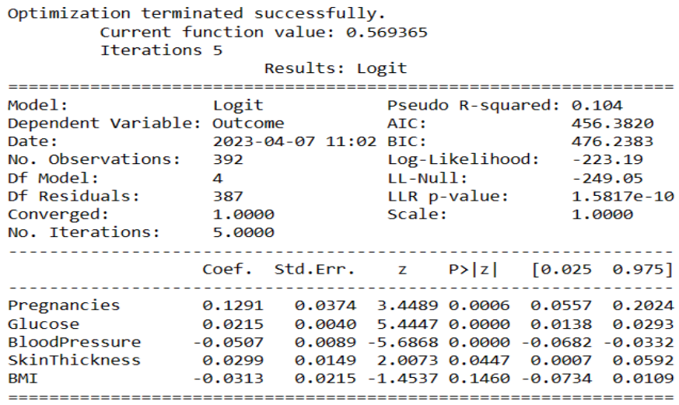
Diabetes prediction using Pregnancies, Glucose, Blood Pressure, Skin Thickness, BMI
(MODEL 2)
Interpretation:
R-squared value: 56.9365%
Here BMI is not contributing significantly. So, we will eliminate in the next model.

Slide 33


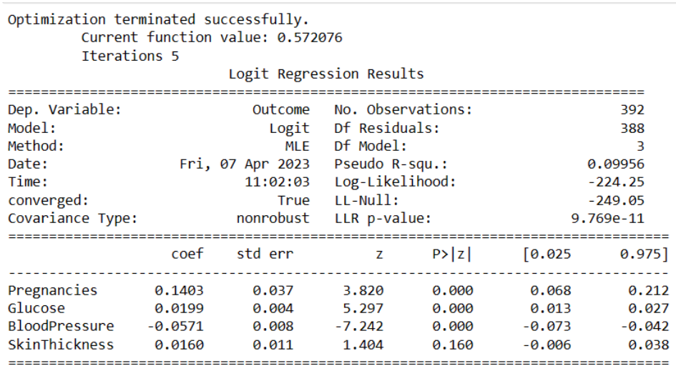
Diabetes prediction using Pregnancies, Glucose, Blood Pressure, Skin Thickness
(MODEL 3)
Interpretation:
R-squared value: 57.2076%
Here Skin Thickness is not contributing significantly. So, we will eliminate in the next model.

Slide 34
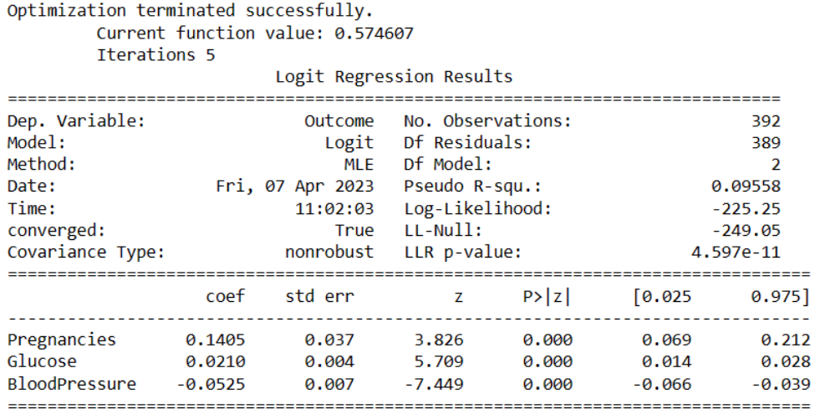
Diabetes prediction using Pregnancies, Glucose, Blood Pressure.
(MODEL 4)
Interpretation:
R-squared value: 57.4607%
Now the model is final where we have 3 variable that influence the outcome most and they are Pregnancies, Glucose, Blood Pressure

Slide 35
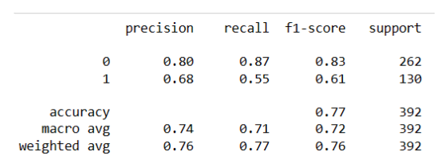
Accuracy and Precision of model
It can be seen from the following output that our model has 80% precision when female does not have diabetes and have 68% precision when the female has diabetes. Overall, our model has a 76% precision to predict the outcome which is a moderately good fit.
Interpretation

Slide 36
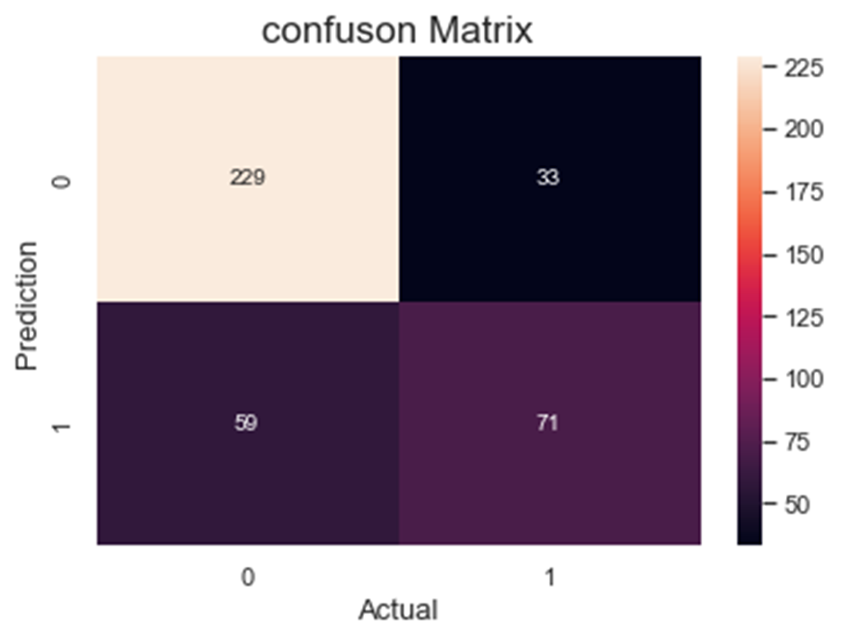
Confusion matrix and precision of model
1.
The confusion matrix gives us 229+71 = 300 correct predictions and 59+33 = 92 incorrect predictions.
2.
The accuracy is 300/392 = 0.765306. So, our model predicts the correct output with 76.53% accuracy.
3.
The error rate of our model is 92/392 = 0.234693. So, our model gives wrong predictions 23.46% times.

Slide 37
CONCLUSION
1
2
3
In our dataset, the pairs BMI & Skin Thickness and Pregnancies & Age have positive linear relationships. Another likely suspect is Glucose and Insulin. So, there is a statistically significant association between these pair of variables.
From the logistic regression model which have R-squared value 57.4607% we conclude that out of 8 independent covariates in the dataset “Pregnancies”, “Glucose” and “Blood Pressure” are most significant factors in predicting the presence of diabetes in females.
Finally we have a model with 76.53% accuracy and 23.46% error rate, which concludes that increase in the glucose level, greater number of pregnancies, low levels of blood pressure and the family history can increase the risk of diabetes in a female.

Slide 38
REFERENCE
Books:
The Fundamentals of Statistics (Vol-I and Vol-II) – A.M. Goon, M.K. Gupta and B Dasgupta
The Fundamentals of Applied Statistics – Gupta and Kapoor
Websites:
https://www.kaggle.com/datasets/uciml/pima-indiansdiabetes-database
https://www.geeksforgeeks.org/
https://www150.statcan.gc.ca/n1/edu/powerpouvoir/ch9/histo/5214822-eng.htm
https://www.statology.org
https://docs.scipy.org/doc/scipy/reference/generated/s cipy.stats.shapiro.html
https://statisticsglobe.com

Slide 39


